Slide 1
Relational Model
Databases Systems [BS-IV(cs/se)] [Spring 2022]
Muhammad Hussain Mughal
Most of the content was taken from slides of book “Database System Concepts, 7th Ed, Silberschatz, Korth and Sudarshan”

Slide 2
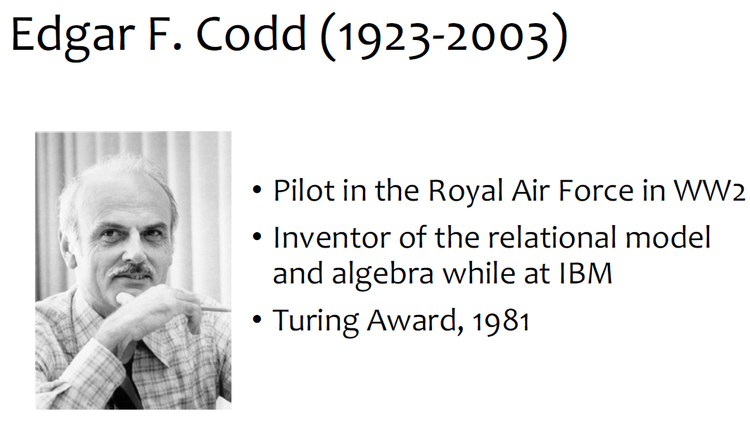
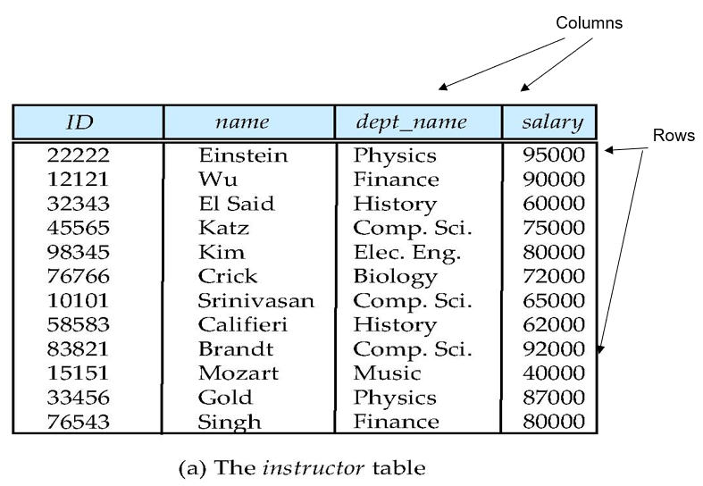
Relational Model
- Database is a collection of Relations (or Tables)
- Each relation has a set of attributes (or Columns)
- Each attribute has a name and a domain (or Type)
- Atomic Values (no Set-valued attribute)
- Each relation contains a set of tuples (or rows)
- Each tuple has value for each attribute of the relation
- No duplicate tuples
- Two tuples are duplicates if they agree on all attributes
Simplicity is the power of this model
Notes:
Relational Data Model:- In the relational model, data are represented in the form of tables. Each table has multiple columns, and each column has a unique name. Each row of the table represents
one piece of information. Figure 1.1 presents a sample relational database comprising two tables: one shows details of university instructors and the other shows details of the various university departments.
The first table, the instructor table, shows, for example, that an instructor named Einstein with ID 22222 is a member of the Physics department and has an annual salary of $95,000. The second table, department, shows, for example, that the Biology department is located in the Watson building and has a budget of $90,000. Of course, a real-world university would have many more departments and instructors.
In general, a row in a table represents a relationship among a set of values. Since a table is a collection of such relationships, there is a close correspondence between the concept of table and the mathematical concept of relation, from which the relational
data model takes its name. In mathematical terminology, a tuple is simply a sequence (or list) of values. A relationship between n values is represented mathematically by an n-tuple of values, that is, a tuple with n values, which corresponds to a row in a table. Thus, in the relational model the term relation is used to refer to a table, while the term tuple is used to refer to a row. Similarly, the term attribute refers to a column of a
table.

Slide 3
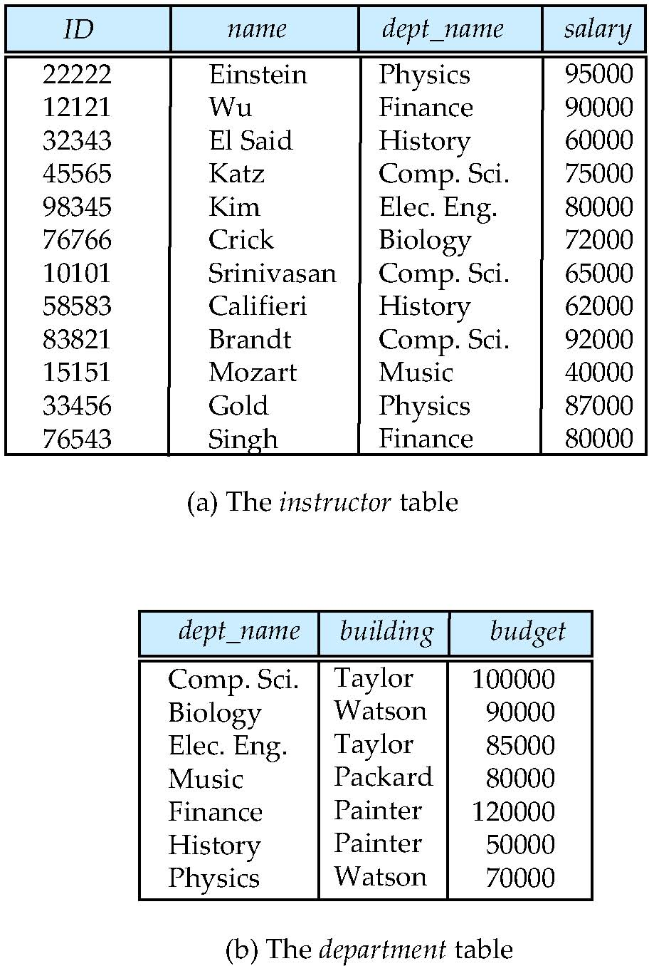
A Sample Relational Database
Order of tuples is irrelevant (tuples may be stored in an arbitrary order)

Slide 4
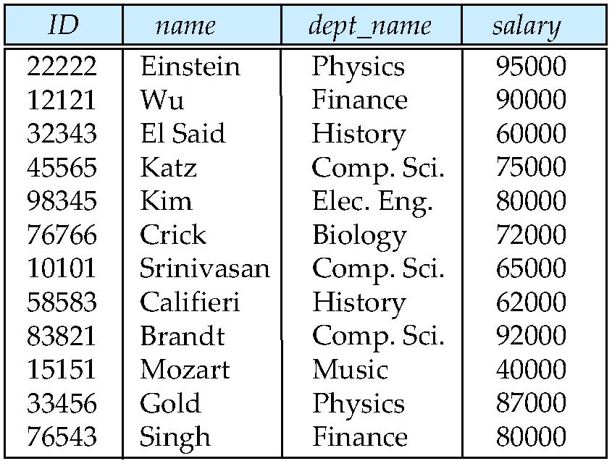
Database Schema
Database schema -- is the logical structure of the database.
Database instance -- is a snapshot of the data in the database at a given instant in time.
Example:
schema: instructor (ID, name, dept_name, salary)
Instance:
Notes:
When we talk about a database, we must differentiate between the database schema, which is the logical design of the database, and the database instance, which is a snapshot of the data in the database at a given instant in time.
We use the term relation instance to refer to a specific instance of a relation, that is, containing a specific set of rows. The instance of instructor shown in Figure 2.1 has 12 tuples, corresponding to 12 instructors.
We require that, for all relations r, the domains of all attributes of r be atomic. A domain is atomic if elements of the domain are considered to be indivisible units. For example, suppose the table instructor had an attribute phone number, which can
store a set of phone numbers corresponding to the instructor.

Slide 5
Attribute
Attribute values
• are atomic; that is, indivisible
• have a known domain
• can sometimes be “null”; member of every domain; Indicated that the value is “unknown”
Attribute Domain
• The set of allowed values for each attribute
– EmployeeAge = Int[15,80]
• Domains may have default values
The null value causes complications in the definition of many operations

Slide 6
Keys
Super key
a set of attributes whose values together uniquely identify a tuple in a relation
Candidate Key
a super key for which no proper subset is a super key:
a super key that is minimal
Can be more than one for a relation
Primary Key
a candidate key chosen to be the main key
One for each relation,
indicated by underlining the key attributes
Student(studno,name,tutor,year)
Notes:
We must have a way to specify how tuples within a given relation are distinguished. This is expressed in terms of their attributes. That is, the values of the attribute values of a tuple must be such that they can uniquely identify the tuple. In other words, no two tuples in a relation are allowed to have exactly the same value for all attributes.
A superkey is a set of one or more attributes that, taken collectively, allow us to identify uniquely a tuple in the relation. For example, the ID attribute of the relation instructor is sufficient to distinguish one instructor tuple from another. Thus, ID is a
superkey. The name attribute of instructor, on the other hand, is not a superkey, because several instructors might have the same name.
A superkey may contain extraneous attributes. For example, the combination of ID and name is a superkey for the relation instructor. If K is a superkey, then so is any superset of K. We are often interested in superkeys for which no proper subset is a
superkey. Such minimal superkeys are called candidate keys. It is possible that several distinct sets of attributes could serve as a candidate key.
Suppose that a combination of name and dept name is sufficient to distinguish among members of the instructor relation. Then, both {ID} and {name, dept name} are candidate keys. Although the attributes ID and name together can distinguish instructor tuples, their combination, {ID, name}, does not form a candidate key, since the attribute ID alone is a candidate key.
We shall use the term primary key to denote a candidate key that is chosen by the database designer as the principal means of identifying tuples within a relation. A key (whether primary, candidate, or super) is a property of the entire relation, rather than
of the individual tuples. Any two individual tuples in the relation are prohibited from having the same value on the key attributes at the same time.
we consider another type of constraint on the contents of relations, called
foreign-key constraints. Consider the attribute dept name of the instructor relation. It
would not make sense for a tuple in instructor to have a value for dept name that does not
correspond to a department in the department relation. Thus, in any database instance,
given any tuple, say ta, from the instructor relation, there must be some tuple, say tb, in
the department relation such that the value of the dept name attribute of ta is the same
as the value of the primary key, dept name, of tb.
A foreign-key constraint from attribute(s) A of relation r1 to the primary-key B of
relation r2 states that on any database instance, the value of A for each tuple in r1 must
also be the value of B for some tuple in r2. Attribute set A is called a foreign key from r1,
referencing r2. The relation r1 is also called the referencing relation of the foreign-key
constraint, and r2 is called the referenced relation.

Slide 7
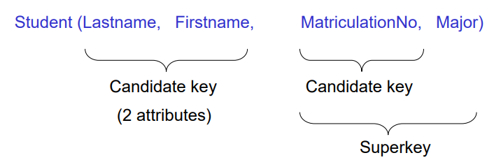
Example: Multiple Keys
Candidate keys are
{Lastname, Firstname} and {StudentID}

Slide 8
Foreign Key
A set of attributes in a relation that exactly matches the primary key in another relation
– the names of the attributes don’t have to be the same but must be of the same domain
Student (studno, name, hons, teacher, classroom, year)
Staff (lecturer, roomno, HoD)
Notation:
FK1: Student (tutor, tutorroom) references Staff (lecturer, roomno)
FK2: Staff (appraiser, approom) references Staff (lecturer, roomno)

Slide 9
Relational Query Languages
Procedural versus non-procedural, or declarative “Pure” languages:
Relational algebra
Tuple relational calculus
Domain relational calculus
The above 3 pure languages are equivalent in computing power
Notes:
A query language is a language in which a user requests information from the database.
These languages are usually on a level higher than that of a standard programming
language. Query languages can be categorized as imperative, functional, or declarative.
In an imperative query language, the user instructs the system to perform a specific
sequence of operations on the database to compute the desired result; such languages
usually have a notion of state variables, which are updated in the course of the computation.
In a functional query language, the computation is expressed as the evaluation of
functions that may operate on data in the database or on the results of other functions;
functions are side-effect free, and they do not update the program state. In a declarative
query language, the user describes the desired information without giving a specific
sequence of steps or function calls for obtaining that information; the desired information
is typically described using some form of mathematical logic

Slide 10
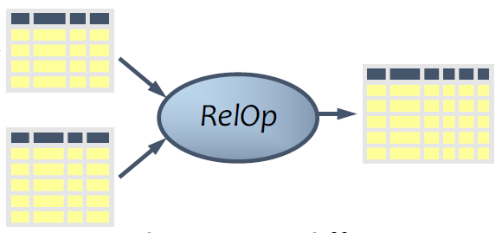
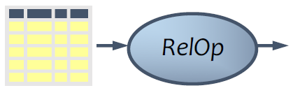
Relational algebra
A procedural language for querying relational database
Consisting of a set of operations that take one or two relations as input and produce a new relation as their result.
Six basic operators
select: σ
project: ∏
union: ∪
set difference: –
Cartesian product: x
rename: ρ
Notes:
The relational algebra consists of a set of operations that take one or two relations as
input and produce a new relation as their result.
Some of these operations, such as the select, project, and rename operations, are
called unary operations because they operate on one relation. The other operations,
such as union, Cartesian product, and set difference, operate on pairs of relations and
are, therefore, called binary operations

Slide 12
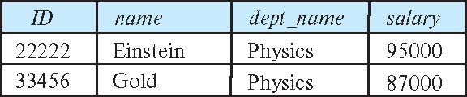
Select Operation
The select operation selects tuples that satisfy a given predicate.
Notation: σ_{p}(r)
p is called the selection predicate
Example: select those tuples of the instructor relation where the instructor is in the “Physics” department.
Query
σ_{dept_name=“Physics”} (instructor)
Result

Slide 13
Select Operation (Cont.)
We allow comparisons using
=, ≠, >, ≥. <. ≤ (in the selection predicate.)
We can combine several predicates into a larger predicate by using the connectives:
∧ (and), ∨ (or), ¬ (not)
Example: Find the instructors in Physics with a salary greater 90,000
σ _{dept_name=“Physics”} ∧ _{salary > 90,000} (instructor)
Then select predicate may include comparisons between two attributes.
Example: Find all departments whose name is the same as their building name:
σ _{dept_name=building} (department)

Slide 14
Project Operation
A unary operation that returns a set of chosen columns.
Notation:
∏ _{A1,A2,A3 ….Ak} (r)
where A₁, A₂ are attribute names and r is a relation name.
The result is defined as the relation of k columns obtained by erasing the columns that are not listed
Duplicate rows removed from result, since relations are sets

Slide 15
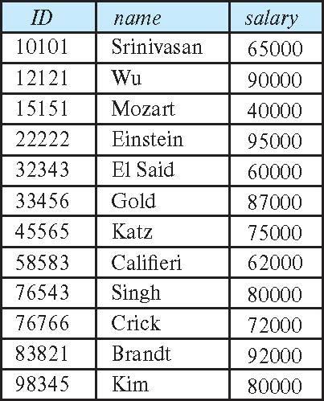
Project Operation (Cont.)
Example: eliminate the dept_name attribute of instructor
Query: ∏_{ID, name, salary} (instructor)
Result:

Slide 16
Composition of Relational Operations
The result of a relational-algebra operation is relation and therefore of relational-algebra operations can be composed together into a relational-algebra expression.
Consider the query -- Find the names of all instructors in the Physics department.
∏_{name}(σ _{dept_name} _{=“Physics”} (instructor))
Instead of giving the name of a relation as the argument of the projection operation, we give an expression that evaluates to a relation.

Slide 17
Cartesian-Product Operation
The Cartesian-product operation (denoted by X) allows us to combine information from any two relations.
Example: the Cartesian product of the relations instructor and teaches is written as:
instructor X teaches
We construct a tuple of the result out of each possible pair of tuples: one from the instructor relation and one from the teaches relation
Since the instructor ID appears in both relations we distinguish between these attribute by attaching to the attribute the name of the relation from which the attribute originally came.
instructor.ID
teaches.ID

Slide 18
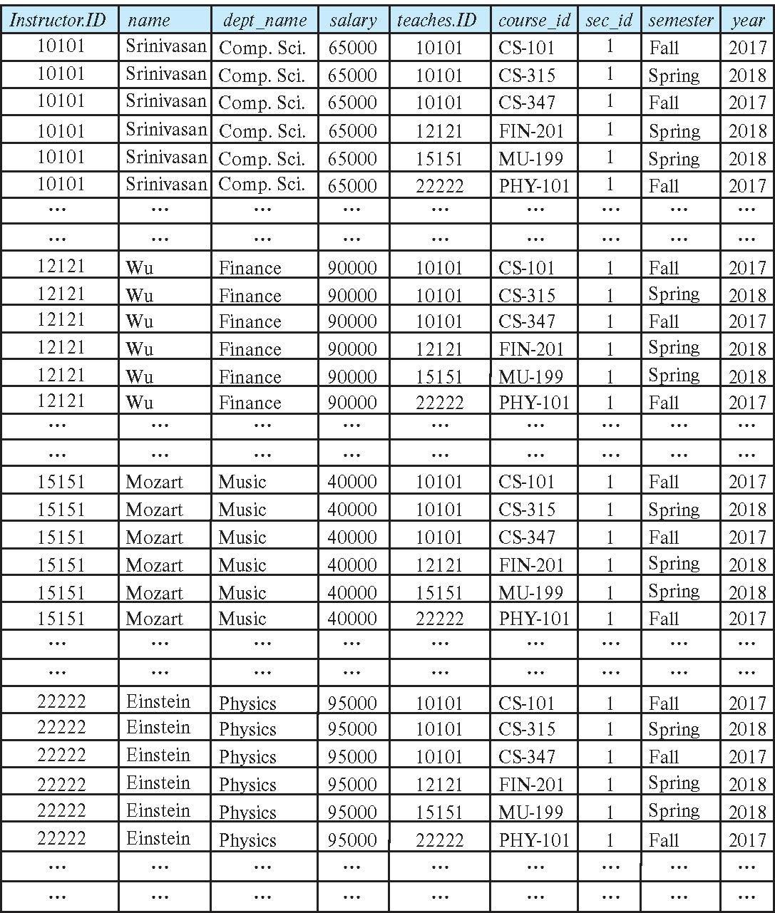
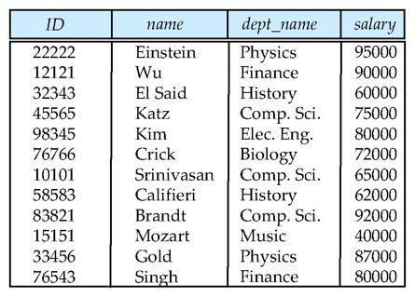
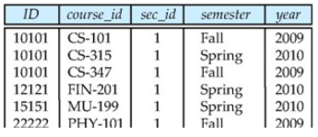
The instructor X teaches table
X

Slide 19
Join Operation
The Cartesian-Product
instructor X teaches
associates every tuple of instructor with every tuple of teaches.
Most of the resulting rows have information about instructors who did NOT teach a particular course ← meaningless
To get only those tuples of “instructor X teaches “ that pertain to instructors and the courses that they taught, we write:
σ _{instructor.id = teaches.id} (instructor x teaches ))
We get only those tuples of “instructor X teaches” that pertain to instructors and the courses that they taught.

Slide 20
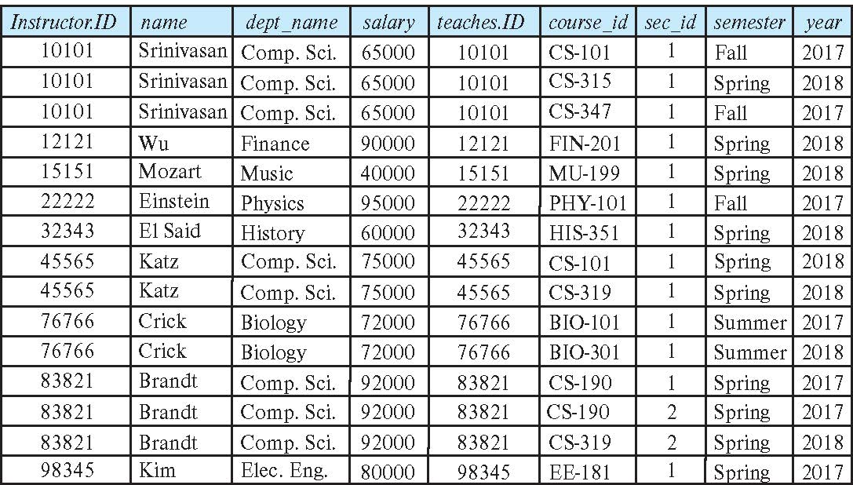
The table corresponding to: σ _{instructor.id = teaches.id} (instructor x teaches))
X
σ _{instructor.id = teaches.id}

Slide 21
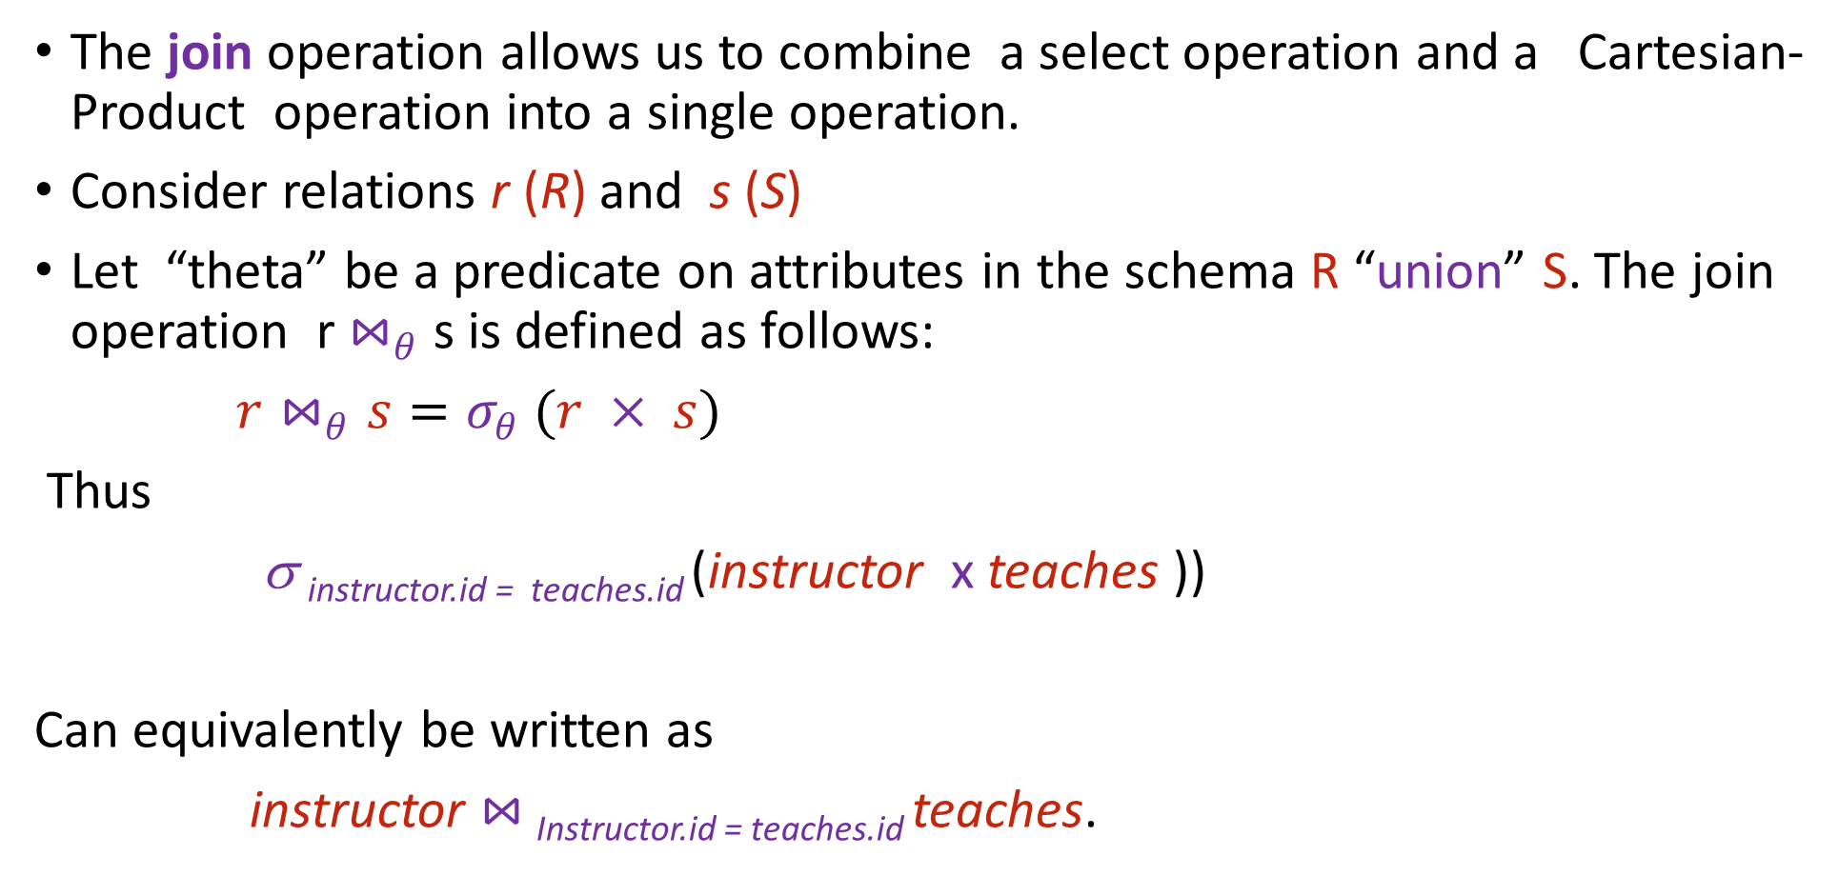
Join Operation (Cont.)
The join operation allows us to combine a select operation and a Cartesian-Product operation into a single operation.
Consider relations r (R) and s (S)
Let “theta” be a predicate on attributes in the schema R “union” S. The join operation r $⋈_{θ}$ s is defined as follows:
$r⋈_{θ}s=σ_{θ} (r × s)$
Thus
σ _{instructor.id = teaches.id} (instructor x teaches ))
Can equivalently be written as
instructor $⋈_{ }$_{Instructor.id = teaches.id} teaches.

Slide 22
Exercise
SID | Sname | Address | CID
S1 | Ali | Sukkur | C4
S2 | Ahmed | Hyd | C2
S3 | Akram | Khi | C2
S4 | Saleem | Sukkur | C3
CID | Cname | CH
C1 | OS | 3
C2 | DBMS | 4
C3 | OOP | 3
C4 | SE | 3

Slide 23
The Assignment Operation
It is convenient at times to write a relational-algebra expression by assigning parts of it to temporary relation variables.
The assignment operation is denoted by ← and works like assignment in a programming language.
Example: Find all instructor in the “Physics” and Music department. Physics ← σ _{dept_name=“Physics”} (instructor)
Music ← σ _{dept_name=“Music”} (instructor)
Physics ∪ Music
With the assignment operation, a query can be written as a sequential program consisting of a series of assignments followed by an expression whose value is displayed as the result of the query.

Slide 24
Types of Joins
Theta join
Natural join
Equi-join
Semi-join
Inner join
Outer join
etc.

Slide 25
Theta Join
A join that involves a predicate
Notation: R1 _{θ} R2 where θ is a condition
Input schemas: R1(A1,…,An), R2(B1,…,Bm)
{A1,…An} {B1,…,Bm} = φ
Output schema: S(A1,…,An,B1,…,Bm)
Derived operator:
R1 _{θ} R2 = σ _{θ} (R1 x R2)

Slide 26
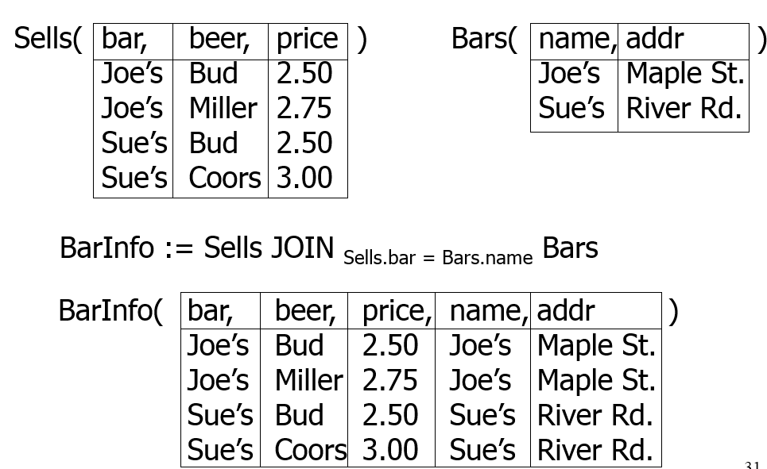
Example

Slide 27
Natural Join
Notation: R1 R2
Input Schema: R1(A1, …, An), R2(B1, …, Bm)
Output Schema: S(C1,…,Cp)
Where {C1, …, Cp} = {A1, …, An} U {B1, …, Bm}
Meaning: combine all pairs of tuples in R1 and R2 that agree on the attributes:
{A1,…,An} {B1,…, Bm} (called the join attributes)
Equivalent to a cross product followed by selection
Example Employee Dependents

Slide 28
Natural Join Example
Employee
Name
SSN
John
999999999
Tony
777777777
Dependents
SSN2
Dname
999999999
Emily
777777777
Joe
Employee Dependents =
P_{Name, SSN, Dname}(σ _{SSN=SSN2}(Employee x σ _{SSN2, Dname}(Dependents)))
Name
SSN
Dname
John
999999999
Emily
Tony
777777777
Joe

Slide 29
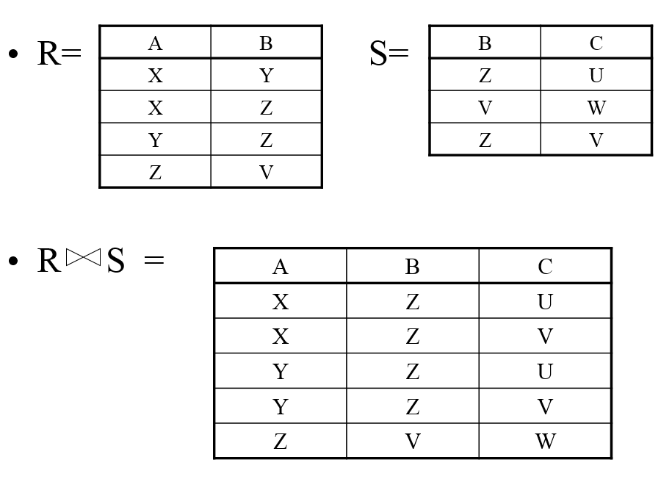
Natural Join

Slide 30
Equi-join
Most frequently used in practice:
R1 _{A=B} R2
Natural join is a particular case of equi-join

Slide 31
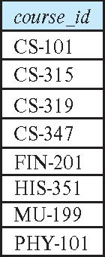
Union Operation
The union operation allows us to combine two relations
Notation: r ∪ s
For r ∪ s to be valid.
1. r, s must have the same arity (same number of attributes)
2. The attribute domains must be compatible (example: 2nd
column of r deals with the same type of values as does the 2nd column of s)
Example: to find all courses taught in the Fall 2017 semester, or in the Spring 2018 semester, or in both ∏_{course_id} (σ _{semester=“Fall” Λ year=2017} (section)) ∪ ∏_{course_id} (σ _{semester=“Spring” Λ year=2018} (section))

Slide 32

Set-Intersection Operation
The set-intersection operation allows us to find tuples that are in both the input relations.
Notation: r ∩ s
Assume:
r, s have the same arity
attributes of r and s are compatible
Example: Find the set of all courses taught in both the Fall 2017 and the Spring 2018 semesters.
∏_{course_id} (σ _{semester=“Fall” Λ year=2017} (section)) ∩ ∏_{course_id} (σ _{semester=“Spring” Λ year=2018} (section))

Slide 33
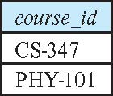
Set Difference Operation
The set-difference operation allows us to find tuples that are in one relation but are not in another.
Notation r – s
Set differences must be taken between compatible relations.
r and s must have the same arity
attribute domains of r and s must be compatible
Example: to find all courses taught in the Fall 2017 semester, but not in the Spring 2018 semester ∏_{course_id} (σ _{semester=“Fall” Λ year=2017} (section)) − ∏_{course_id} (σ _{semester=“Spring” Λ year=2018} (section))

Slide 34
Outer join
To display rows in the result that do not have matching values in the join column, use Outer join.
R S
(Left) outer join is join in which tuples from R that do not have matching values in common columns of S are also included in result relation.

Slide 35
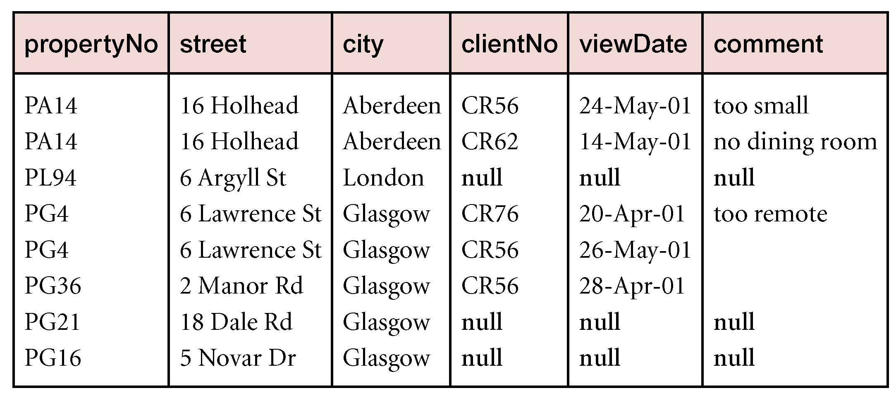
Example - Left Outer join
Produce a status report on property viewings.
Π_{propertyNo, street, city}(PropertyForRent) Viewing

Slide 36
The Rename Operation
The results of relational-algebra expressions do not have a name that we can use to refer to them. The rename operator, ρ , is provided for that purpose
The expression:
ρ_{x} (E)
returns the result of expression E under the name x
Another form of the rename operation:
ρ_{x(A1,A2, .. An)} (E)

Slide 37
Equivalent Queries
There is more than one way to write a query in relational algebra.
Example: Find information about courses taught by instructors in the Physics department with salary greater than 90,000
Query 1
σ _{dept_name=“Physics”} ∧ _{salary > 90,000} (instructor)
Query 2
σ _{dept_name=“Physics”} (σ _{salary > 90.000} (instructor))
The two queries are not identical; they are, however, equivalent -- they give the same result on any database.

Slide 38
Consider the following schema:
Suppliers(sid: integer, sname: string, address: string)
Parts(pid: integer, pname: string, color: string)
Catalog(sid: integer, pid: integer, cost: real)
Find the names of suppliers who supply some red part.
Find the sids of suppliers who supply some red or green part.
Find the sids of suppliers who supply some red part or are at Street No.22 Sadar Karachi.
Find the sids of suppliers who supply some red part and some green part.

Slide 39
Division
R ÷ S
Defines a relation over the attributes C that consists of set of tuples from R that match combination of every tuple in S.
Expressed using basic operations:
T₁ ← Π_{C}(R)
T₂ ← Π_{C}((S X T₁) – R)
T ← T₁ – T₂

Slide 40
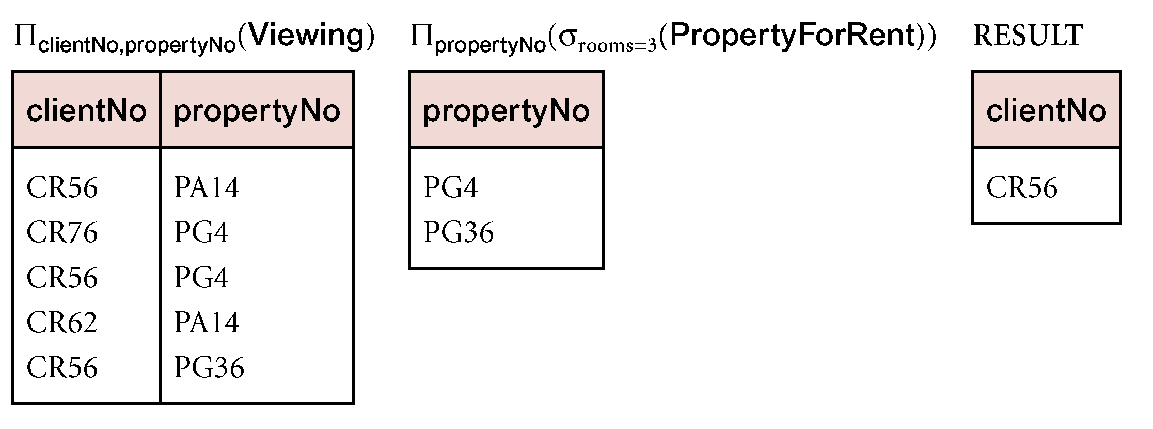
Example - Division
Identify all clients who have viewed all properties with three rooms.
(Π_{clientNo, propertyNo}(Viewing)) ÷
(Π_{propertyNo}(σ_{rooms = 3} (PropertyForRent)))

Slide 41
Consider the following schema:
Suppliers(sid: integer, sname: string, address: string)
Parts(pid: integer, pname: string, color: string)
Catalog(sid: integer, pid: integer, cost: real)
Find the sids of suppliers who supply every part.
Find the sids of suppliers who supply every red part.
Find the sids of suppliers who supply every red or green part.
Find the sids of suppliers who supply every red part or supply every green part.
Find pairs of sids such that the supplier with the first sid charges more for some part than the supplier with the second sid.
Find the pids of parts supplied by at least two different suppliers.

